Slide 1

Natural Language Processing
Anne Cuzeau, Sam Mathieu, Eve Dean

Slide 2
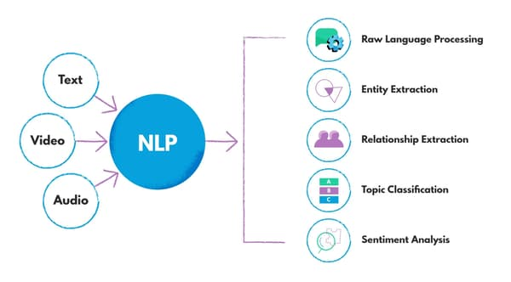
Overview
NLP Processes
Ways to do NLP
What we used
Our Project
Our data & goals
Preprocessing
Sentiment Analysis
Topic Analysis
Notes:
eve

Slide 3
Ways to do NLP
Approaches:
Rule-based methods: uses predefined rules and patterns to extract specific information (eg part-of-speech tagging, sentiment analysis)
Machine learning: uses algorithms to learn patterns and rules from labeled data to classify and extract information from new data (eg named entity recognition, text classification)
Deep learning: uses artificial neural networks to learn patterns and representations of text data (eg sentiment analysis, language translation)
Statistical methods: analyze and extract information from text data (eg frequency analysis, clustering)
Hybrid methods: combines multiple methods, depends on goals
Notes:
Anne

Slide 4
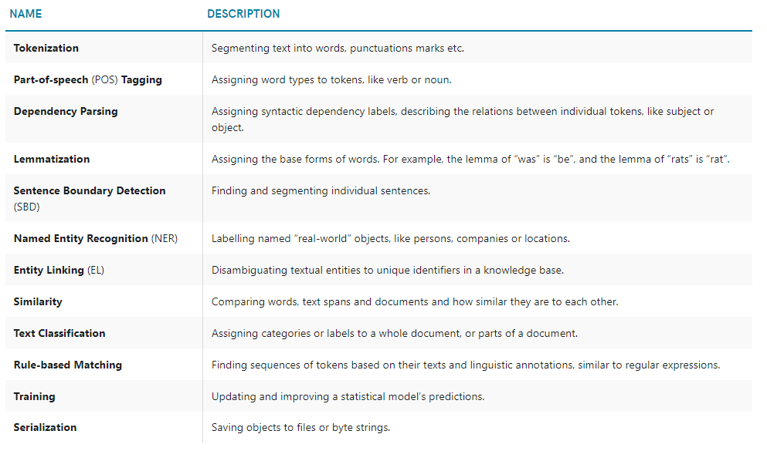
NLP with Spacy
We are using Spacy for NLP
Built in functions for text processing
Part of speech tagging, entity recognition, removing common words, etc.
Incorporate libraries (gender guesser) for pulling specific articles & topics
Sentiment Analysis using Spacy
Textblob - reads in text blobs
Measures ‘polarity’ and ‘subjectivity’
Notes:
Sam

Slide 5
Our Project

Slide 6
Our Data
Year | 1971
Title | Dr J P Eaton of Natl Center for Earthquake Research, other quake specialists, after preliminary study, fear Los Angeles area faces greatest quake ever (W Sullivan rept)
Excerpt | they warn accumulation of strain along fault which skirts San Francisco and passes near Los Angeles threatens quake like one that hit San Francisco in '06; say Los Angeles quake, instead of relieving strain along fault, may have increased it; findings by Dr Franken, Dr Steinbrugge and Dr Franklin outlined Scientists Fear Worse Quake on Coast
Kaggle dataset of New York Times Excerpts from 1920-2020.
Each row represents an individual article
Notes:
Anne

Slide 7
Questions
Feature extraction
What are the common topics, people, and places discussed for each decade?
How often are women mentioned in the news over the decades?
Sentiment Analysis
What are the common sentiments associated with women in the news?
Has the sentiment in articles involving women shifted?
Text Classification/Topic Analysis
What topics are commonly associated with men vs women?
Notes:
Sam

Slide 8
Dealing with Text Datasets
Challenges with our dataset
Very large and inconsistent
File types were not convenient for anything
Lots of missing excerpts
Most titles lacked context
How we dealt with it
Only used a small portion
Used preprocessing to make text simple & consistent
Pulled subsets of data to save as CSVs
Used batch processing
Combined title and excerpts & treated combined text as a single “text blob”

Slide 9
Preprocessing

Slide 10
PreProcessing
Name Entity Recognition: Looking at text entities
Identifies noun chunks as entities
Labels entities: ORG, companies, agencies, institutions, etc.
A new aspirant for Tom Mix's PERSON audiences, named Ken Maynard PERSON , is introduced in a picture entitled " Señor Daredevil WORK_OF_ART ," which is sojourning at the Colony LOC . As the wages of a cowboy are nominal it is no wonder that occasionally a rough-rider should take a chance before the camera, especially when he hears that Mr. Mix PERSON 's income is something like $ 2,000 MONEY a day.

Slide 11
PreProcessing
sentence 1 has noun chunk 'A new aspirant'
sentence 1 has noun chunk 'Tom Mix's audiences'
sentence 1 has noun chunk 'Ken Maynard'
sentence 1 has noun chunk 'a picture'
sentence 1 has noun chunk '"Señor Daredevil'
sentence 1 has noun chunk 'which'
sentence 1 has noun chunk 'the Colony'
Name Entity Recognition: Part of speech tagging
Identifies what words in excerpts are (noun, preposition, verb, etc.)

Slide 12
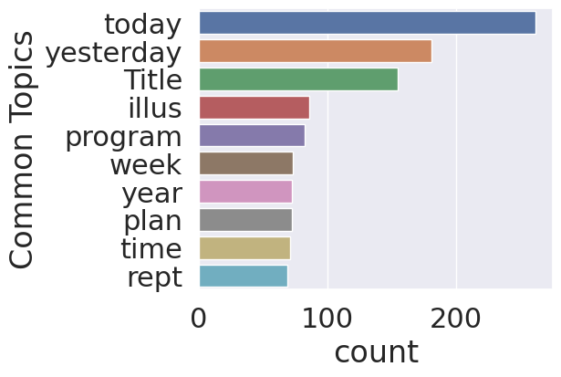
PreProcessing
Looking at what the excerpt talks about: Removing common words
Common words like a, is, in, the are not useful
Removing common words provides a better idea of what is important in the excerpt

Slide 13
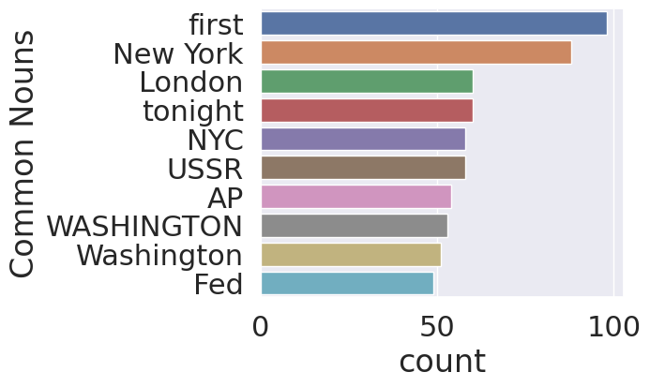
PreProcessing
Looking at what the excerpt talks about: Exploring common entities
Removes common words
Focuses on nouns that are more unique to the excerpt
Indicates significance of article

Slide 14
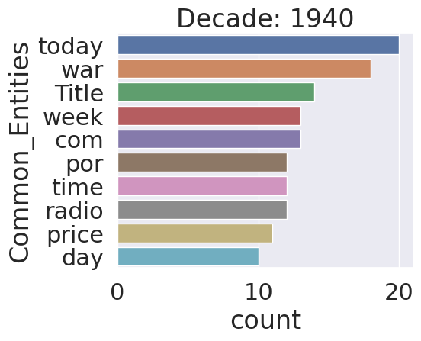
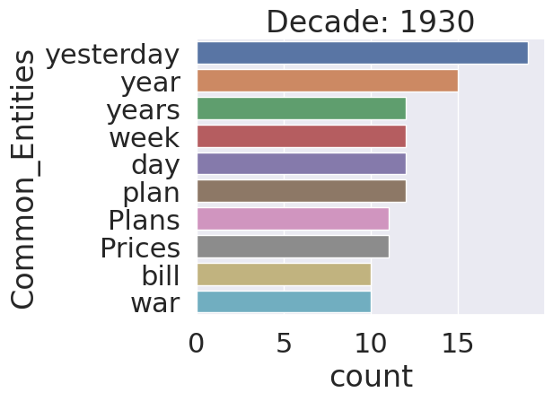
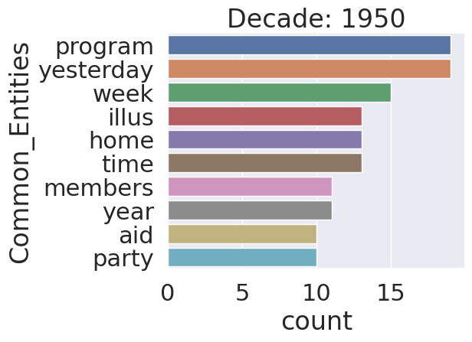
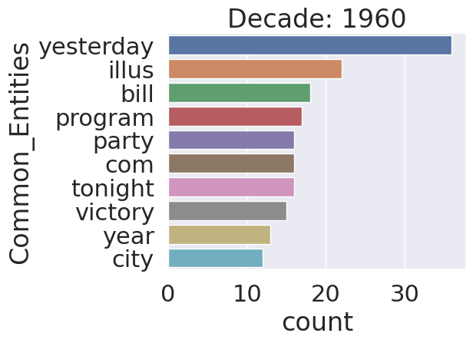
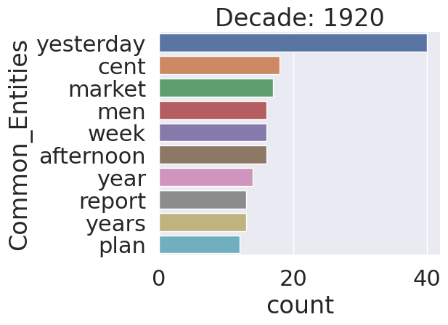
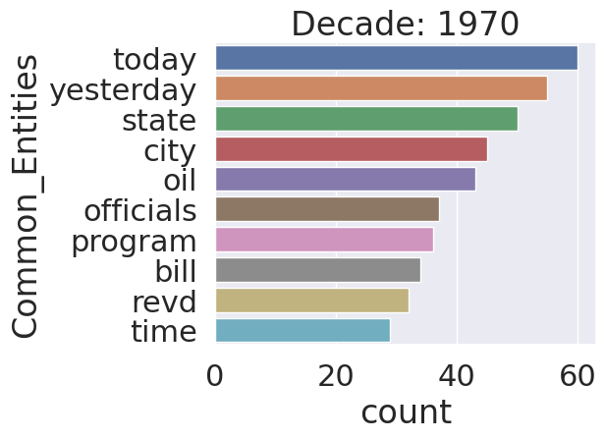
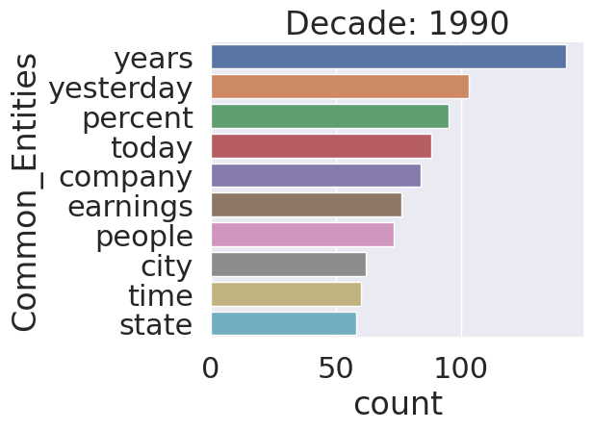
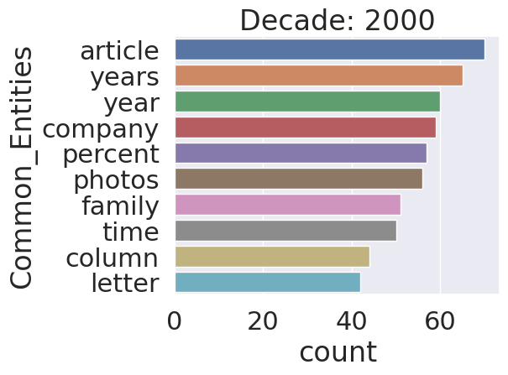
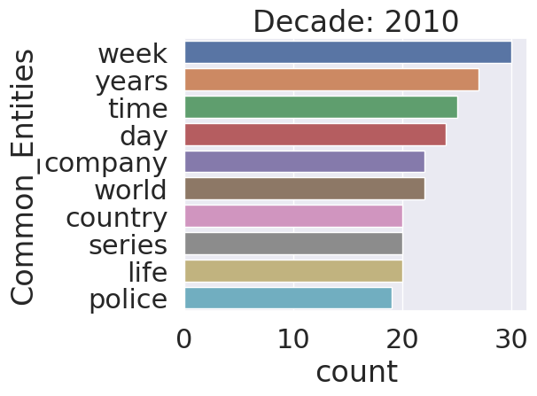
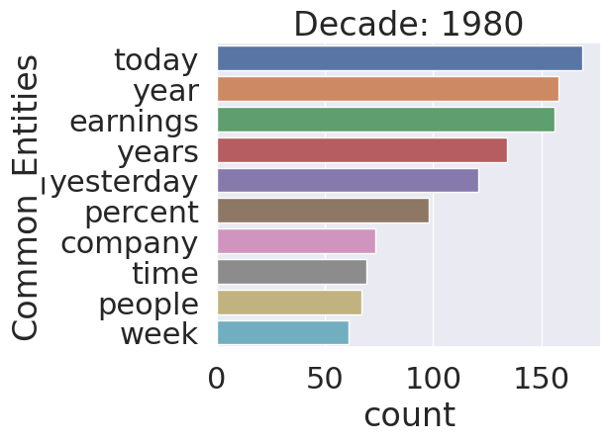
Common Entities by Decade
Looking at what the excerpt talks about by decade
Removes common words
Focuses on nouns that are more unique to the excerpt
Indicates significance of article

Slide 15
Topic Analysis

Slide 16
Comparing articles: men vs women
Methodology for 600 articles/year (ran on Google Cloud):
Isolated articles with pronouns she/her/hers or nouns: woman/women/lady etc.
Looked at both excerpts and titles: added four boolean columns to our dataset
Extracted topics from these articles
Repeated analysis for masculine pronouns and nouns
Not using gender-guesser library:
Storing names in arrays, having to parse through each array, isolate first names → Too much computing for little results

Slide 17
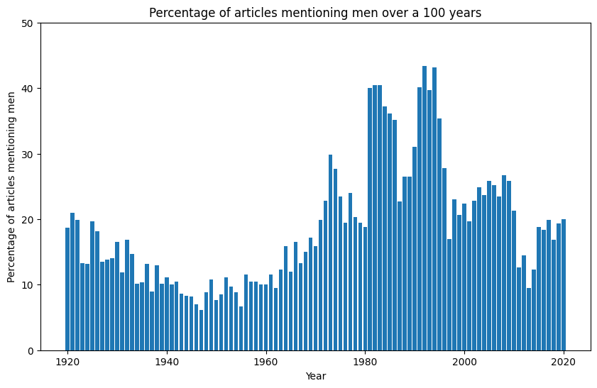
Articles mentioning men vs women

Slide 18
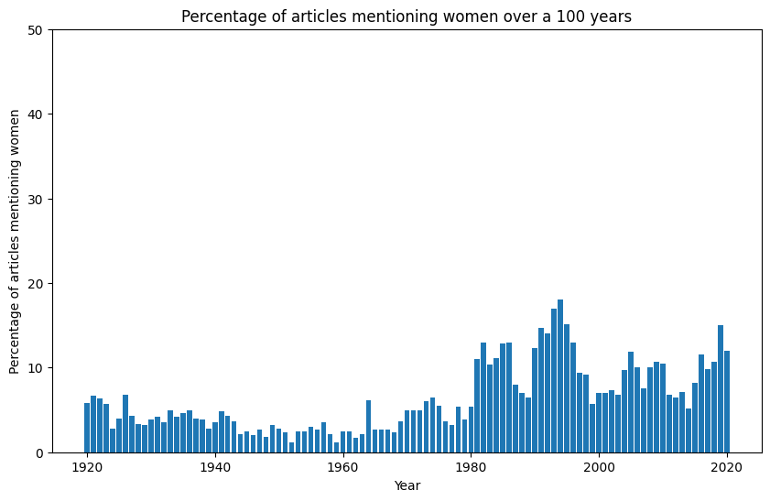
Articles mentioning men vs women

Slide 19
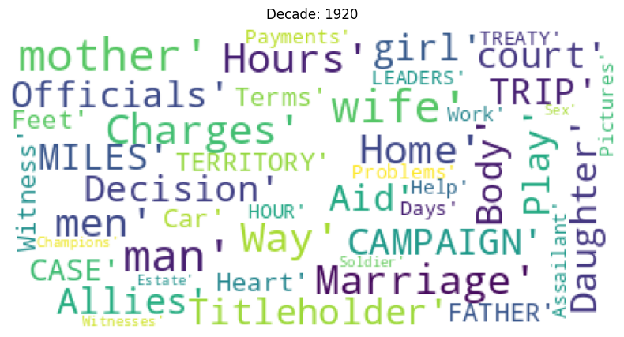
Word Clouds: 1920s

Slide 20
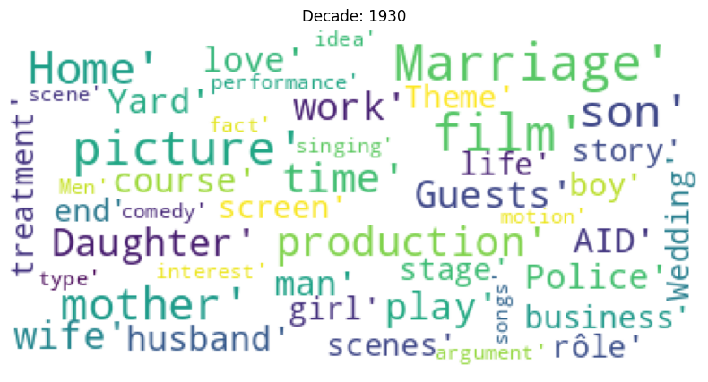
Word Clouds: 1930s

Slide 21
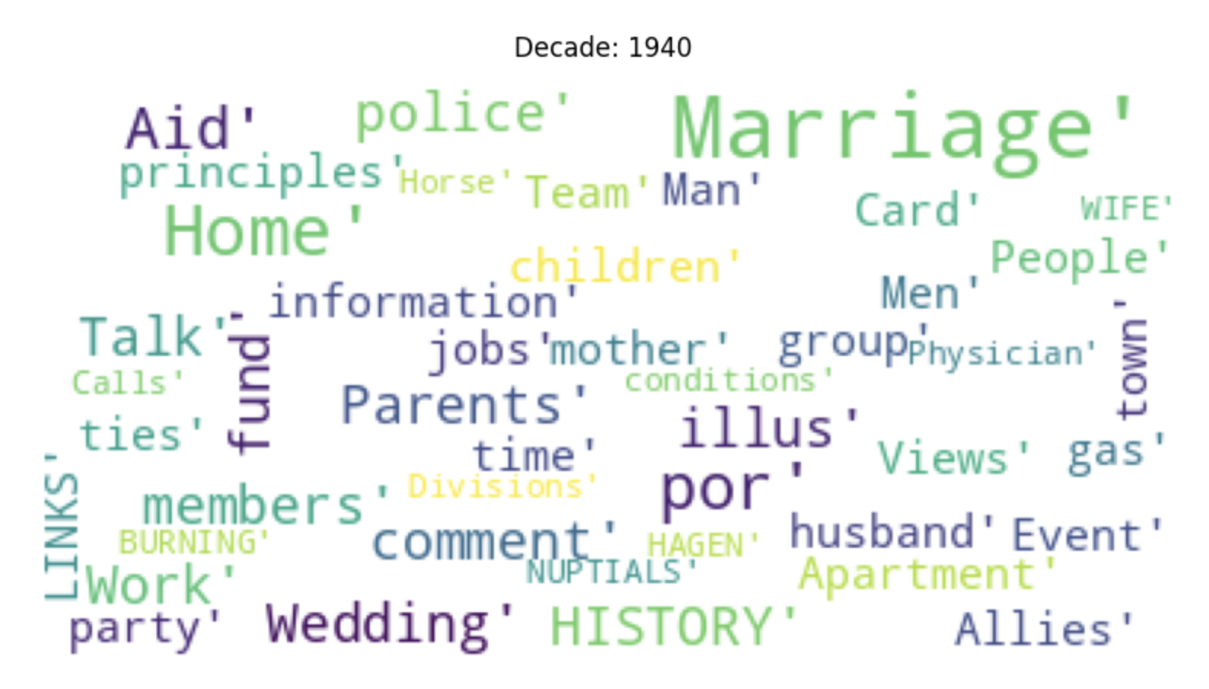
Word Clouds: 1940s

Slide 22
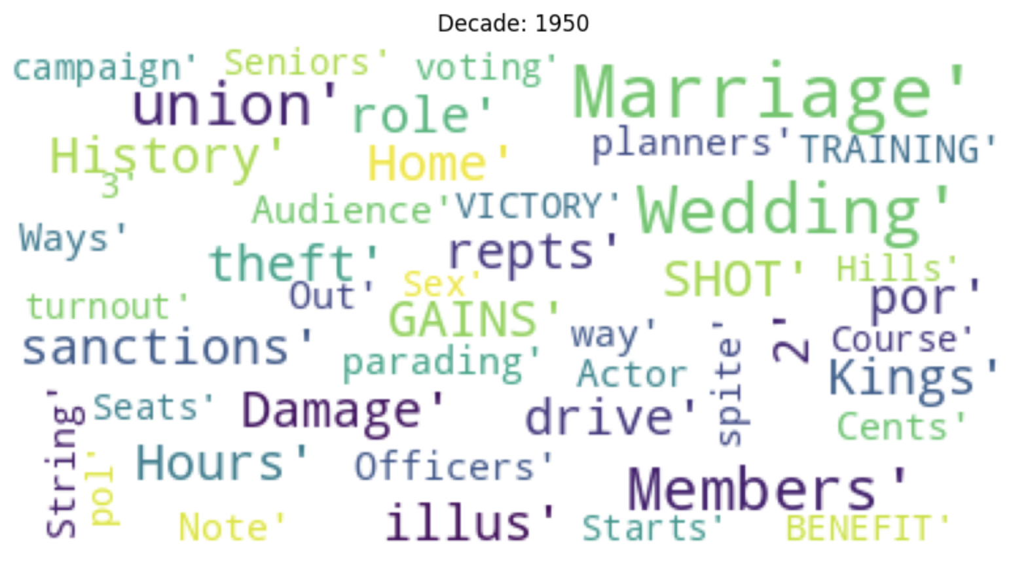
Word Clouds: 1950s

Slide 23
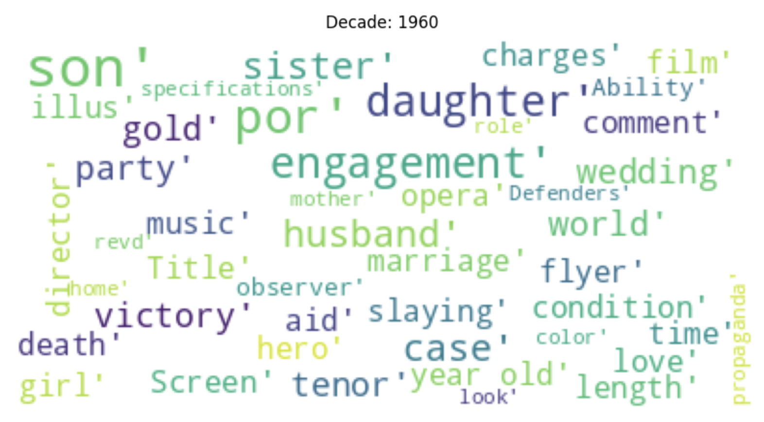
Word Clouds: 1960s

Slide 24
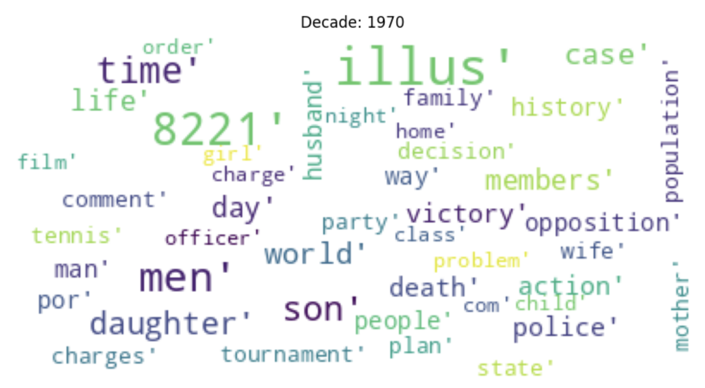
Word Clouds: 1970s

Slide 25
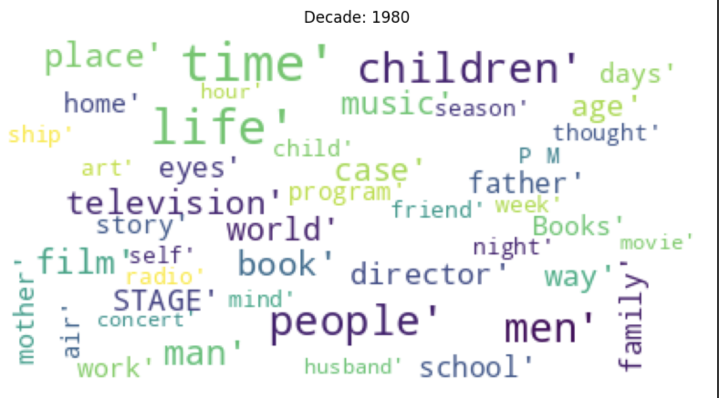
Word Clouds: 1980s

Slide 26
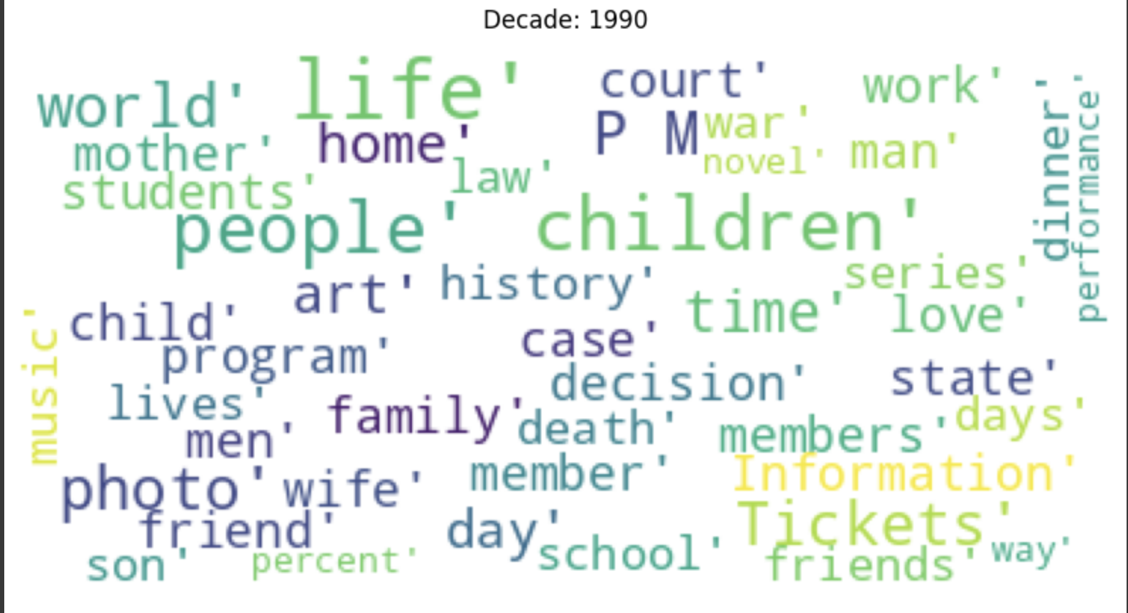
Word Clouds: 1990s

Slide 27
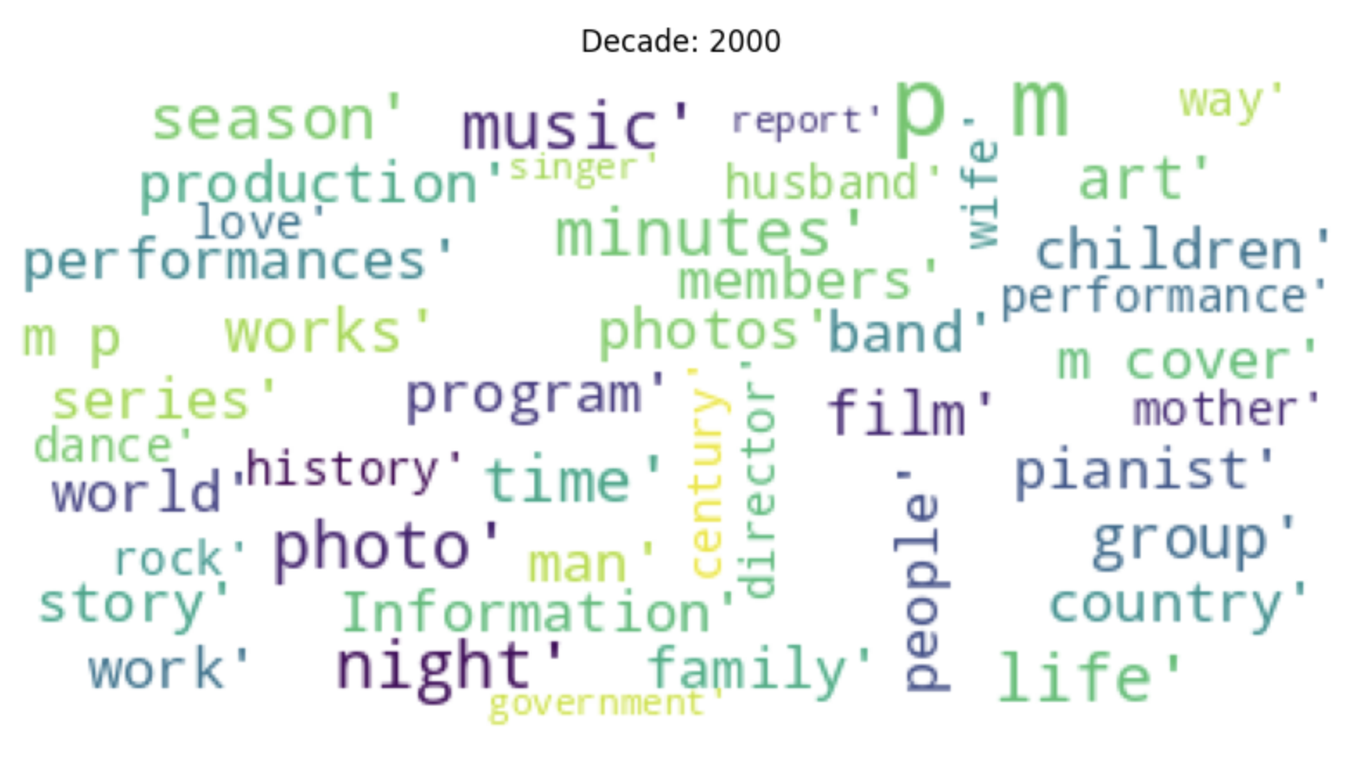
Word Clouds: 2000s

Slide 28
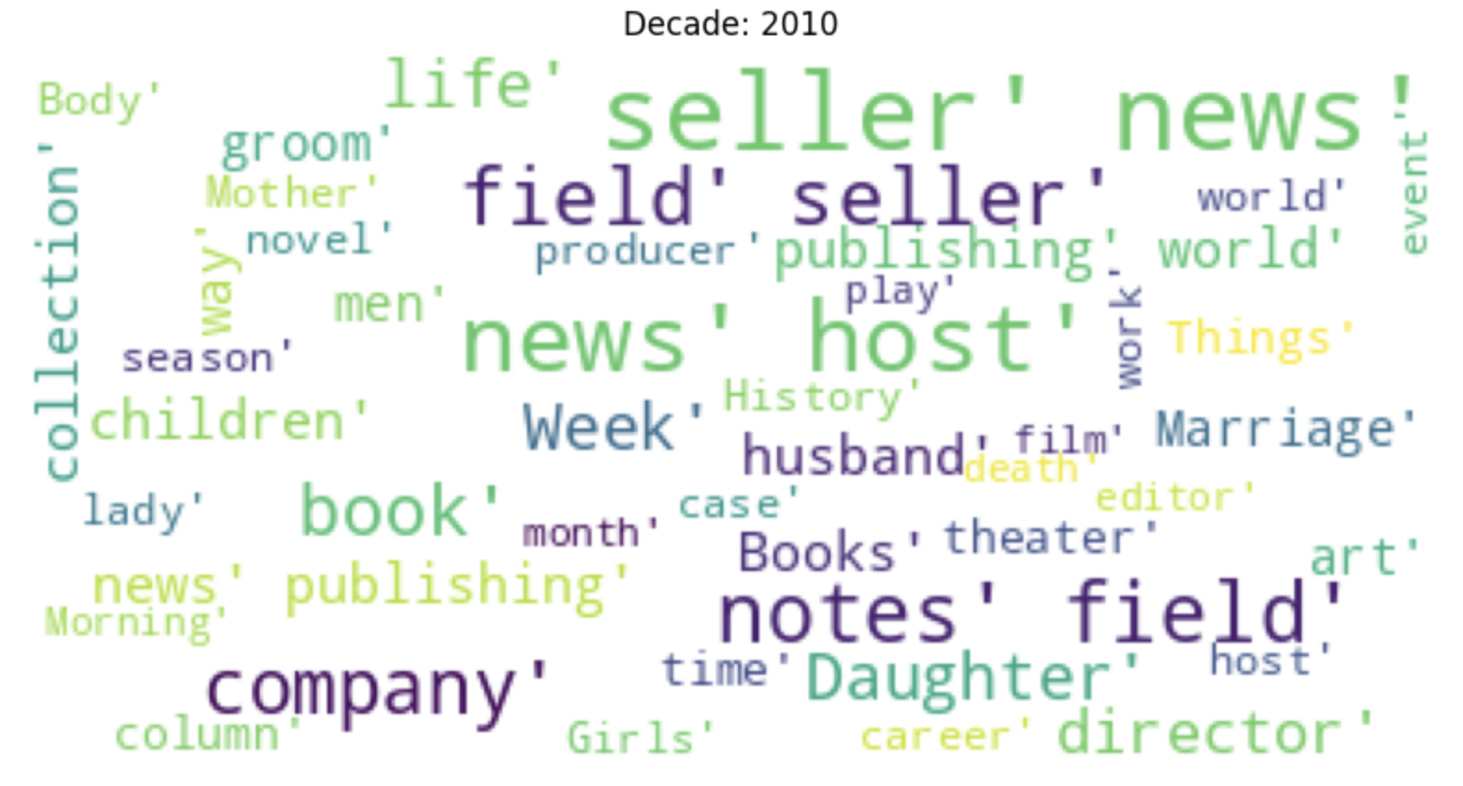
Word Clouds: 2010s

Slide 29
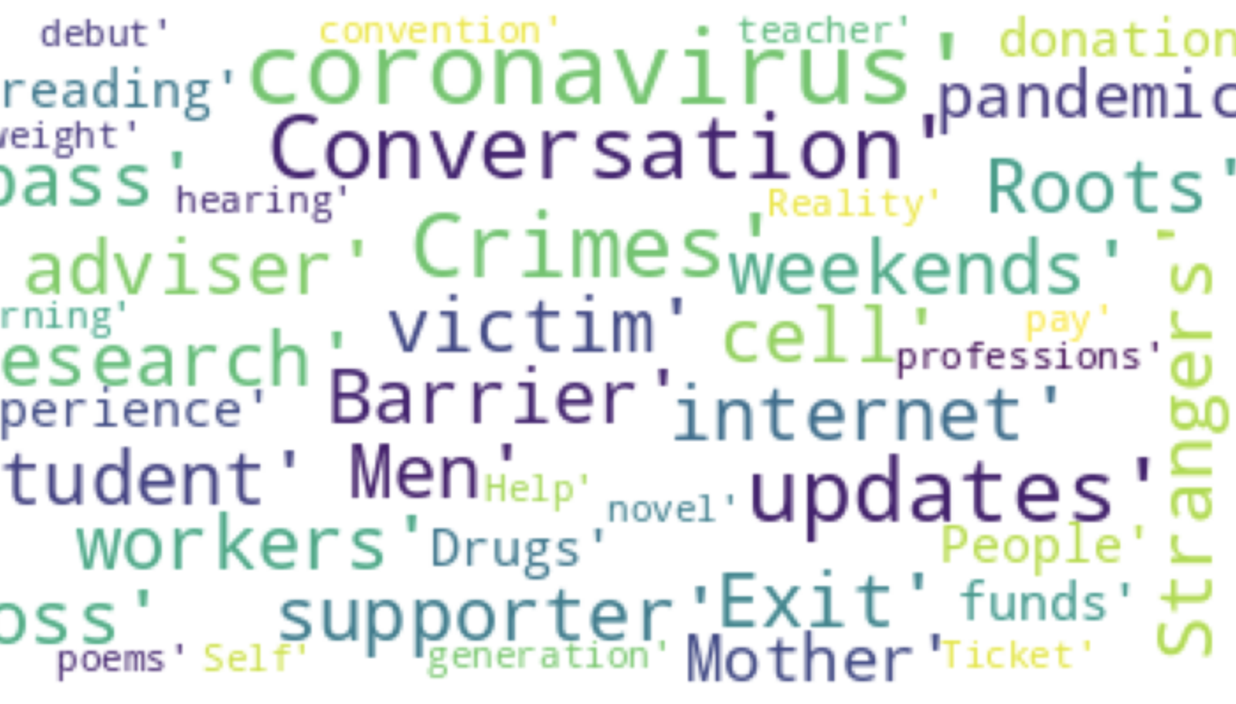
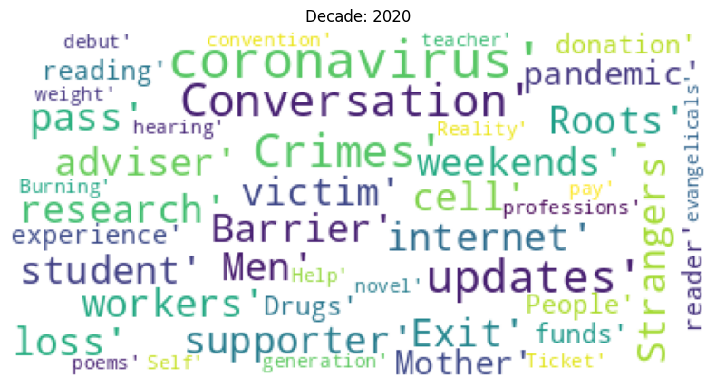
Word Clouds: 2020

Slide 30
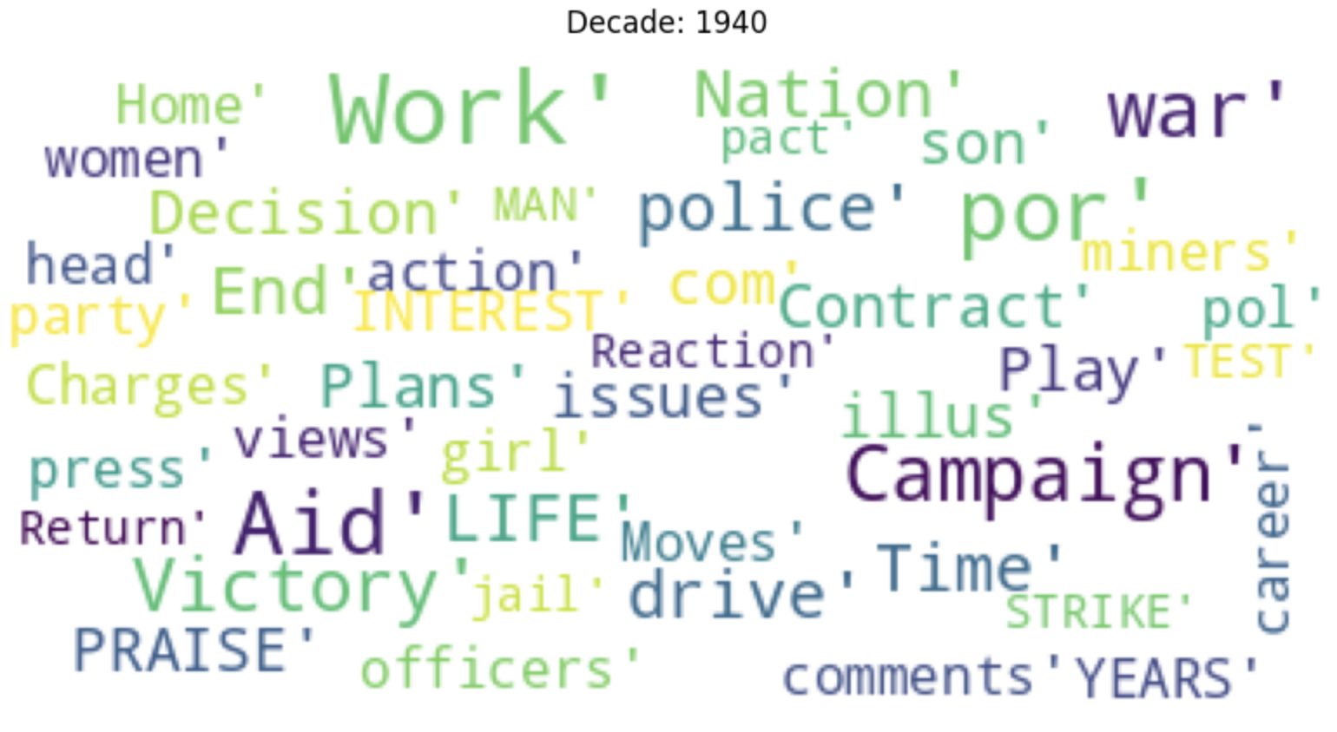
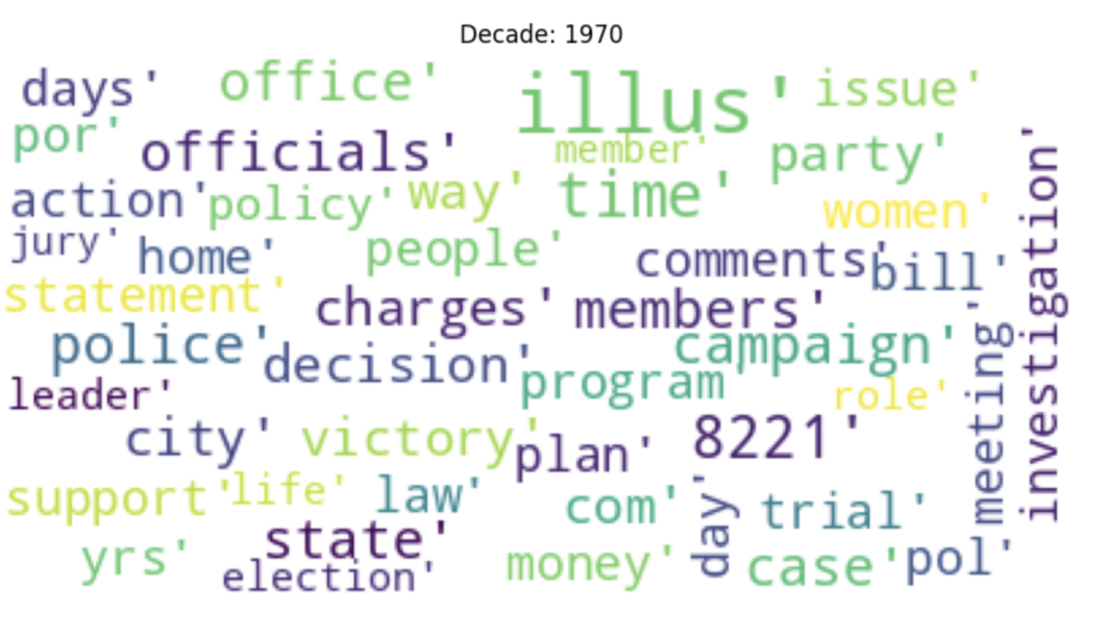
Word Clouds: Men

Slide 31
Key takeaways
For women: most of the twentieth century is family oriented
After 1980: women are mentioned more often → but still very family-oriented
After 2000: women are mentioned more often with more diverse topics
Men: no clear themes in topics regardless of the decade

Slide 32
Sentiment Analysis

Slide 33
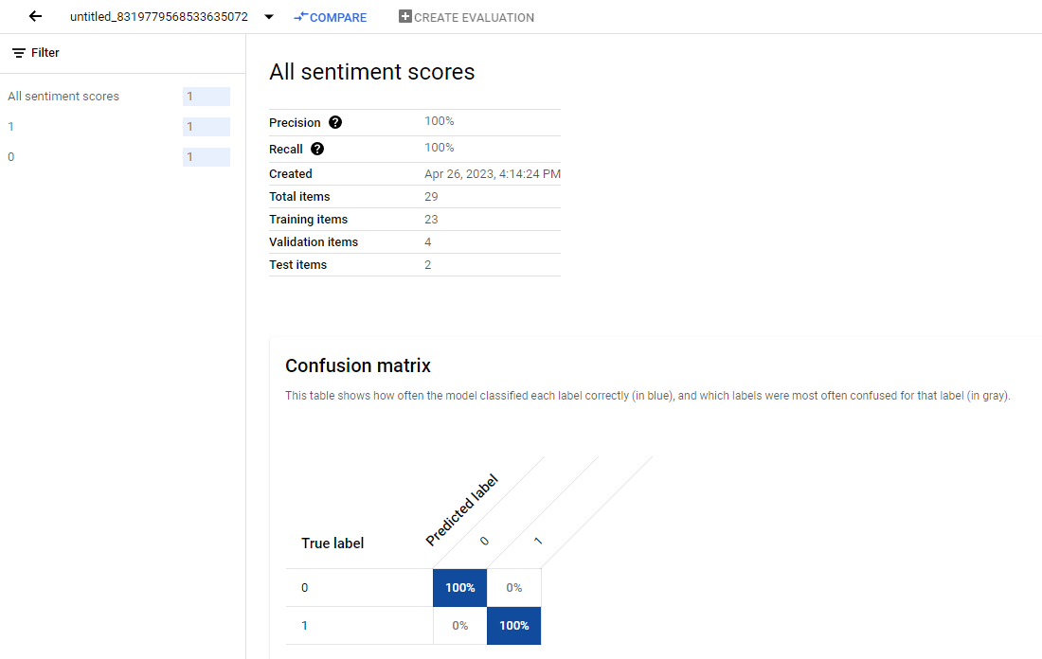
NLP with Vertex AI
Ran a sentiment analysis model but we did not get very far…
Only accepted text file inputs
Max 500 text files
Model ran for 6 hours & cost ~$25
Not time or cost effective with the size of our dataset
Overall not user friendly or useful for our objectives
Notes:
Anne

Slide 34
Sentiment Analysis with Spacy
Used built in functions to assess polarity & subjectivity
Made ‘sentiment’ column
Very positive
Positive
Neutral
Negative
Very Negative
Made a new column ‘intensity’ which is the absolute value of polarity
Polarity: score -1 - 1 based on how positive or negative a statement is
Subjectivity: score 0-1 based on how “subjective” or “objective” a statement is
Notes:
Anne

Slide 35
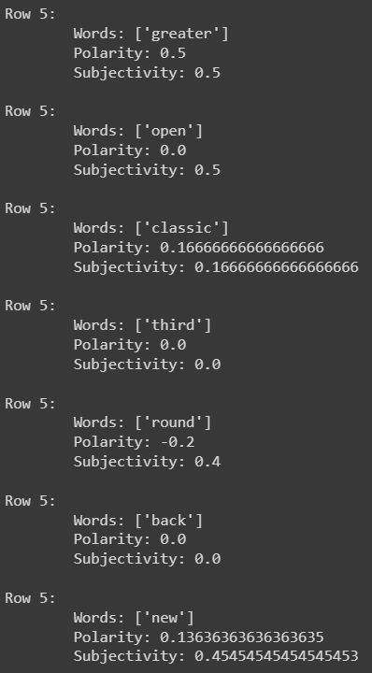
Sentiment Analysis with Spacy
How is it determining polarity & subjectivity:
Pulls words from the dataframe
Scores each word internally
Uses combined scores to compute overall sentence score
Notes:
Anne

Slide 36
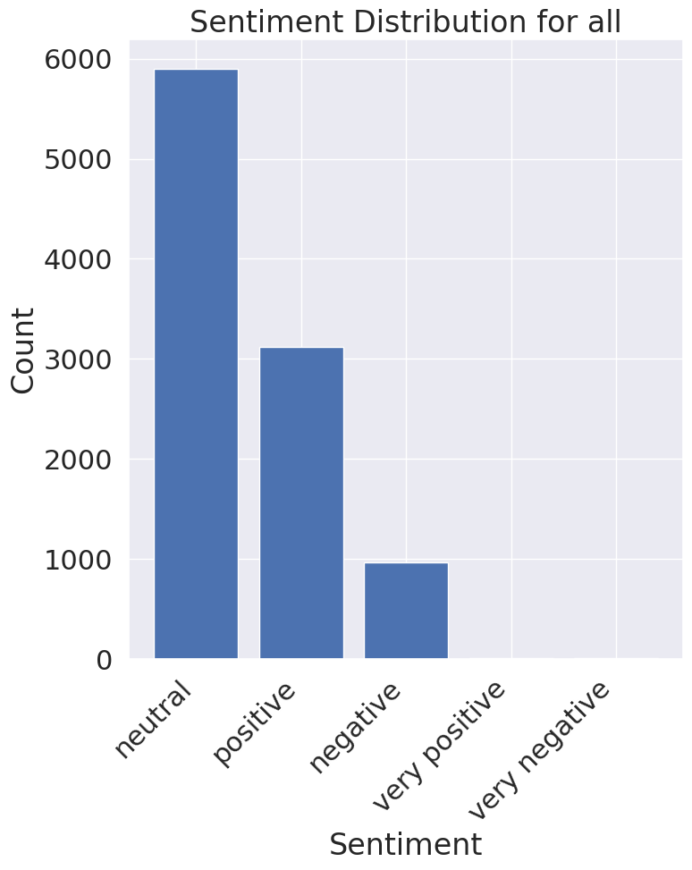
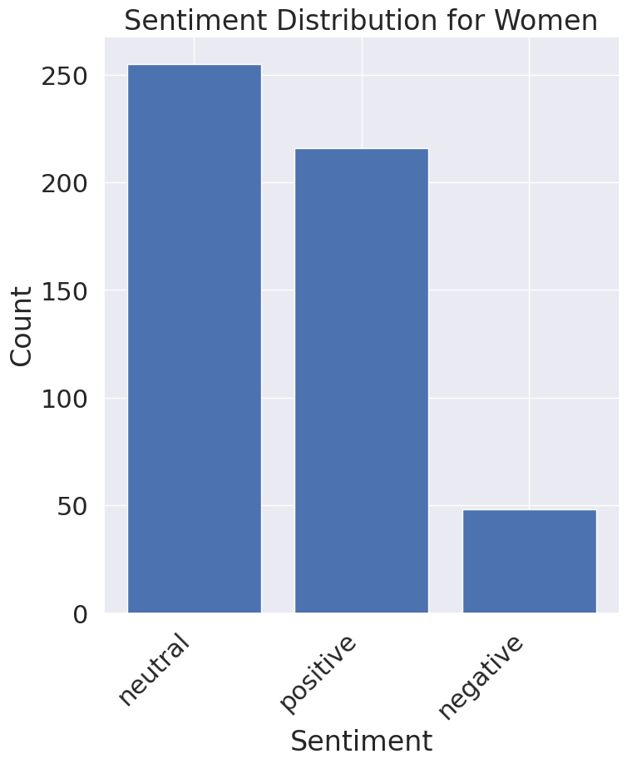
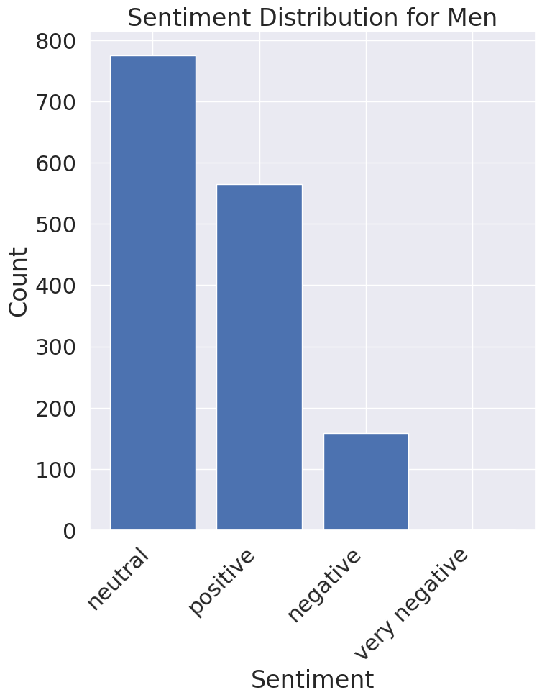
Sentiment Analysis: Sentiment Frequency
Notes:
Anne

Slide 37
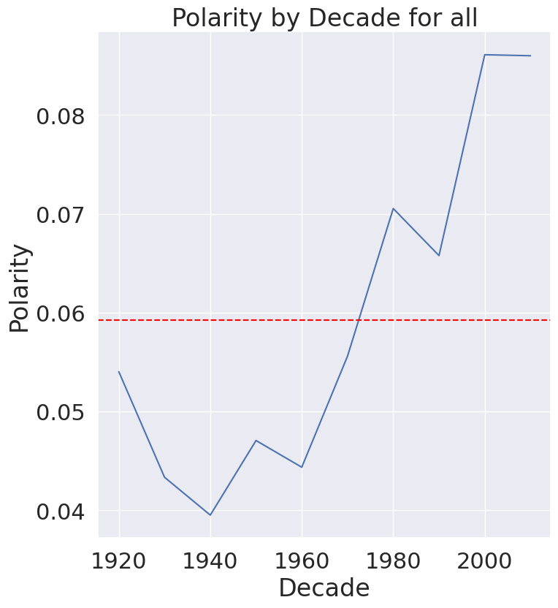
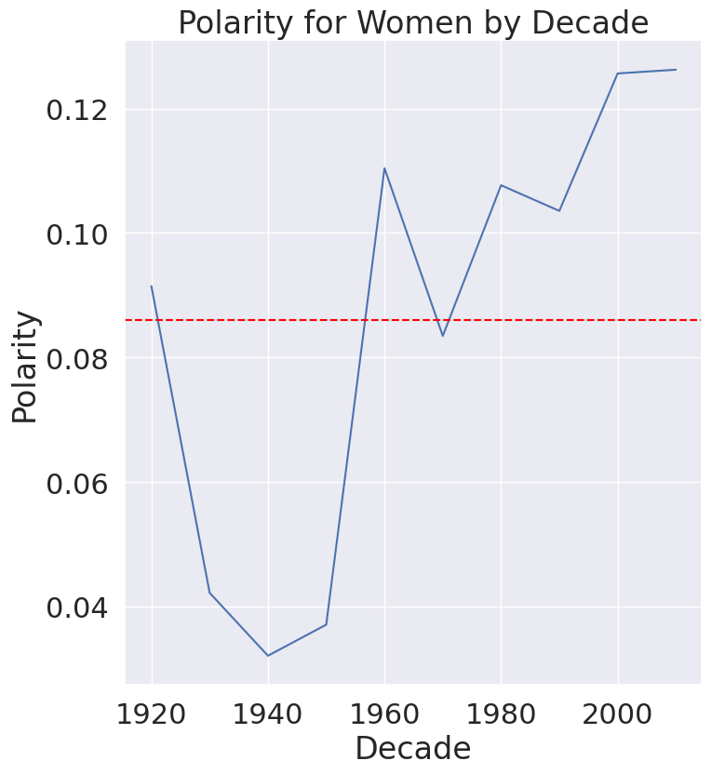
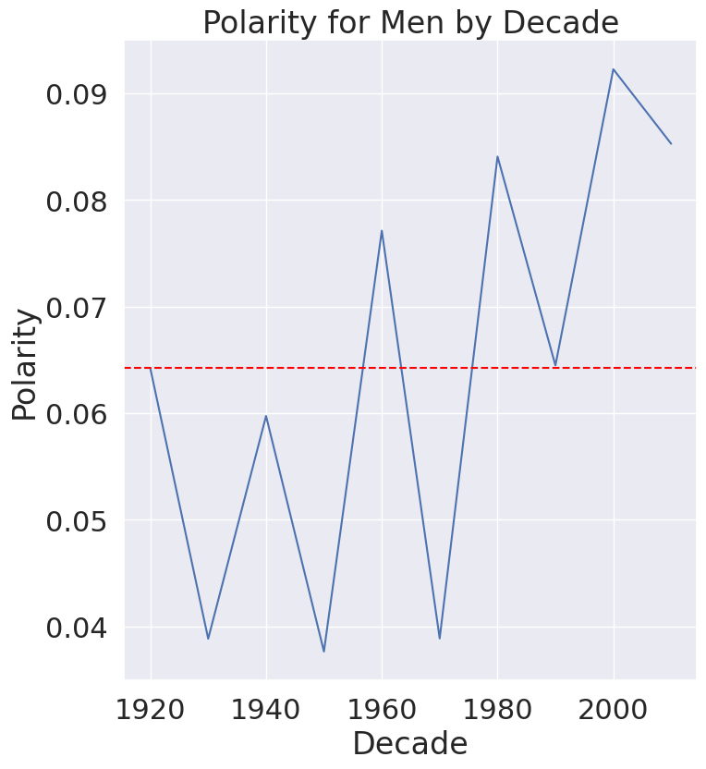
Sentiment Analysis: Polarity
Notes:
Anne

Slide 38
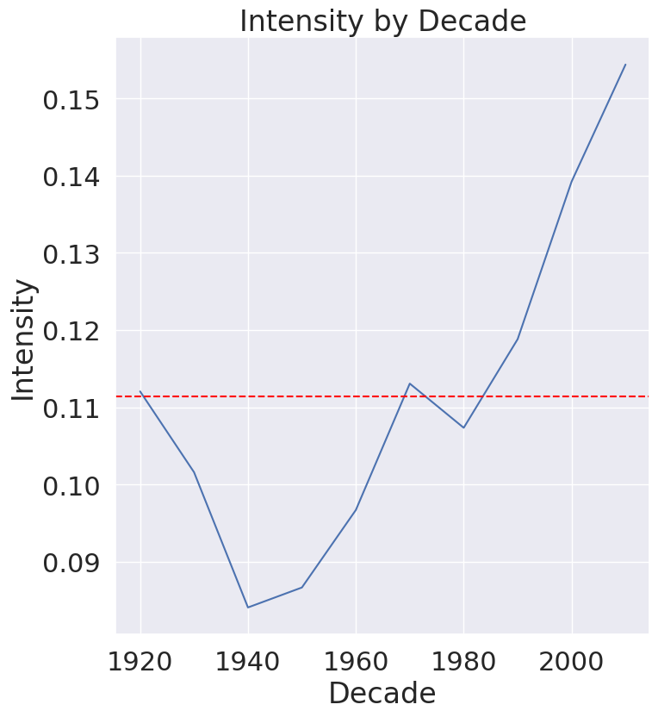
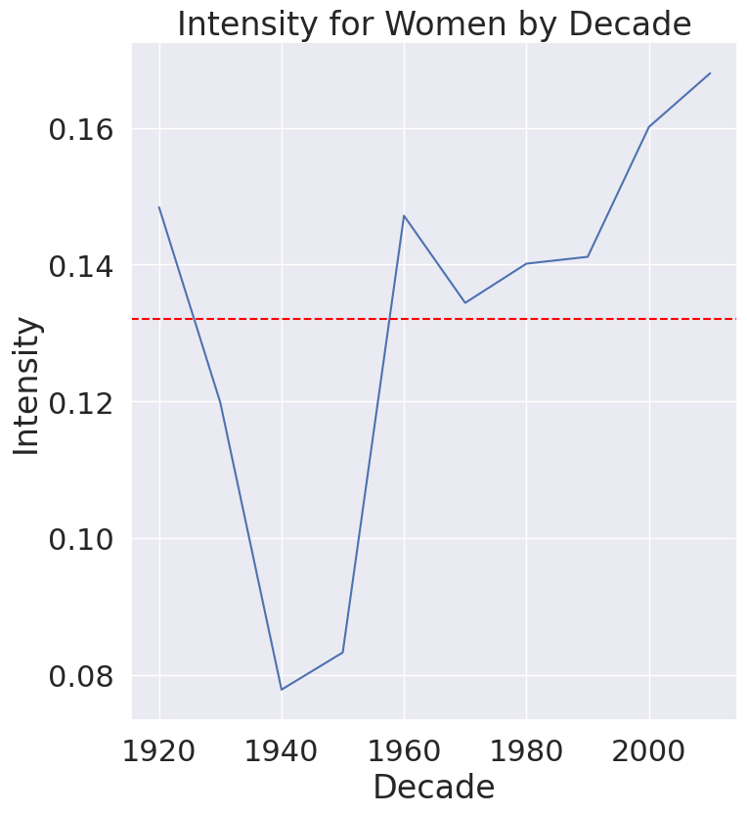
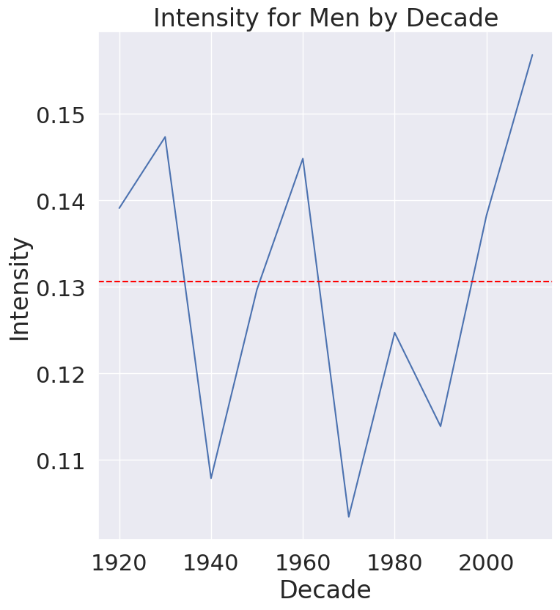
Sentiment Analysis: Intensity
Notes:
Anne

Slide 39
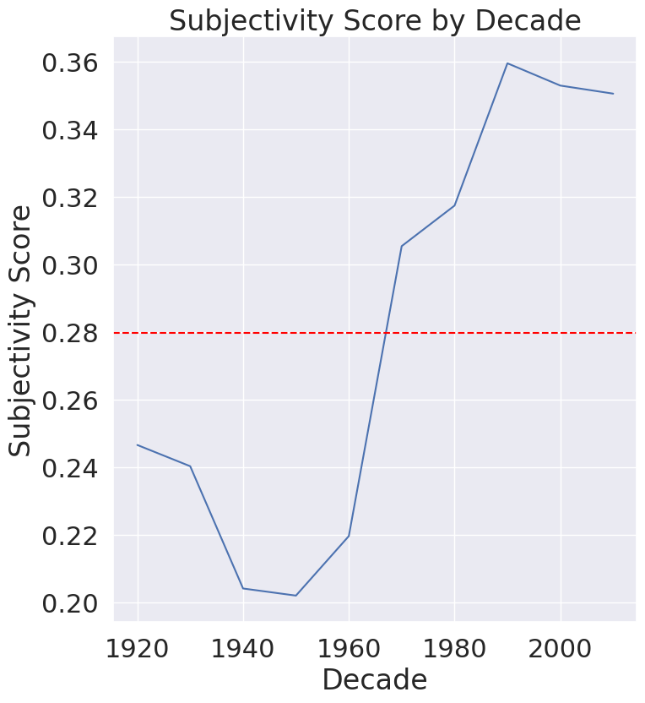
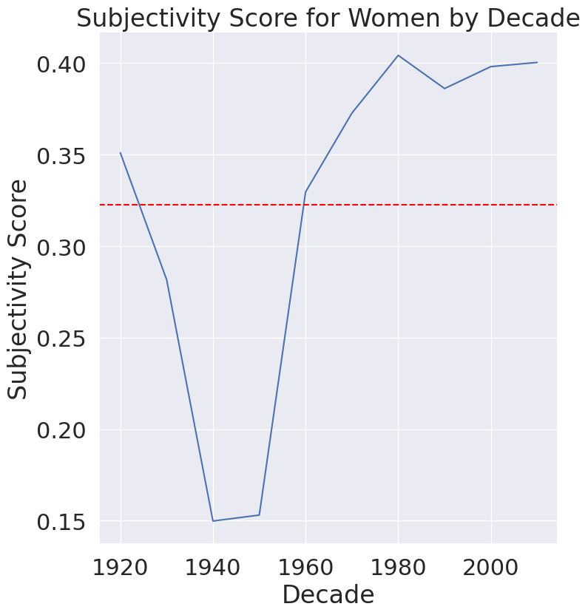
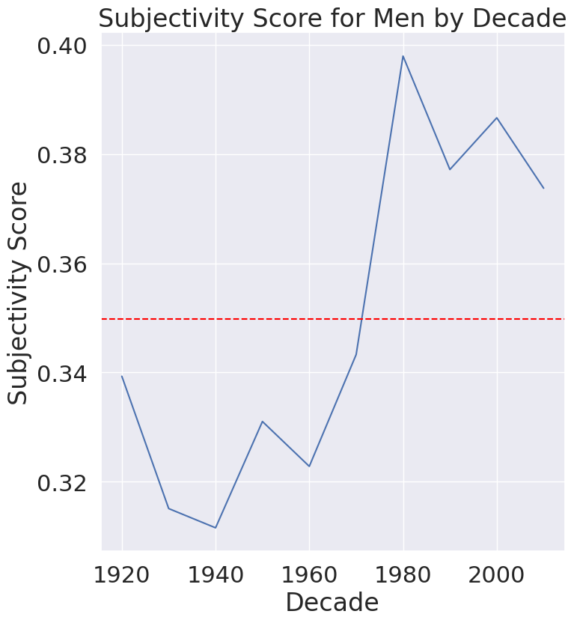
Sentiment Analysis: Subjectivity
Notes:
Anne

Slide 40
Overall Takeaways
Vertex AI seems awesome but can be challenging to use
There are a variety of approaches and applications available for NLP
Women are mentioned far less often than men
Entities in the news vary a lot per decade
Women are more often associated with familial topics
Marriage, children, family, etc.
Clear shift around the 2000s
When women are in the news feelings are on average slightly more positive and less subjective
Notes:
Eve

Slide 41
Thank You
Questions?

Slide 42
Extra slides

Slide 43
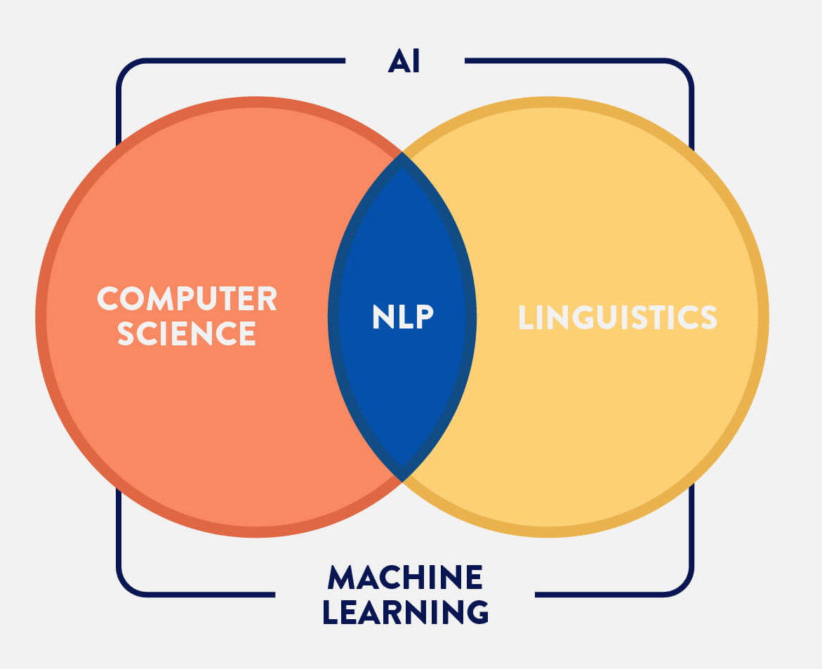
What is NLP?
Natural Language Processing combines computer science and linguistics
Allows computers to understand human language
Subfield within Artificial Intelligence which uses machine learning
Notes:
Eve

Slide 44
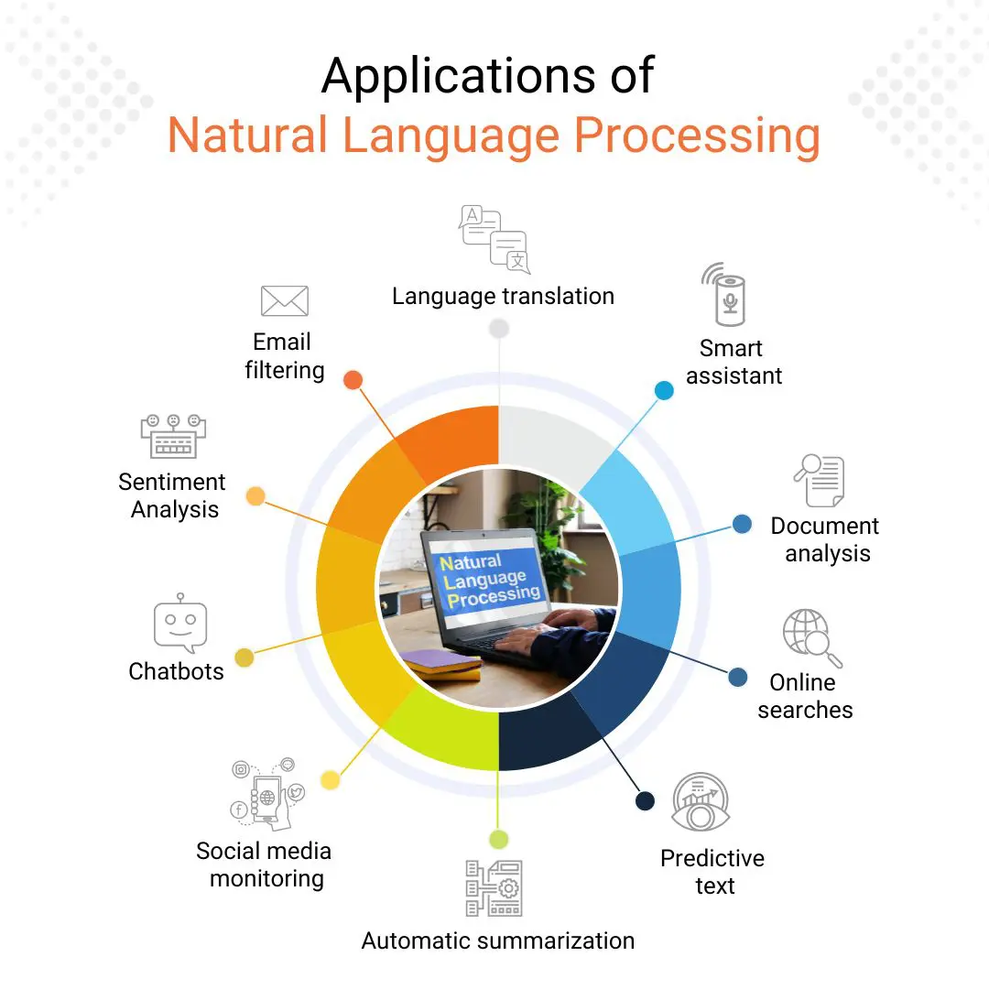
How is NLP used?
Useful for any case where you need to process human language data:
Text analysis
Text summarization
Information search and retrieval
Language translation
Chatbots
Notes:
Eve

Slide 45
How does NLP work?
Data Preprocessing: cleaning and prep for data analysis
Removing punctuation, capitalization, misspellings, dealing with special characters
Make the text as simple as possible
Text Tokenization: breaking text into ‘tokens’
Word or sentence level, can also use custom tokens (eg split by commas)
Feature Extraction: converting text to numerical representation
Bag of words, TF-IDF, word embeddings
Notes:
Eve

Slide 46
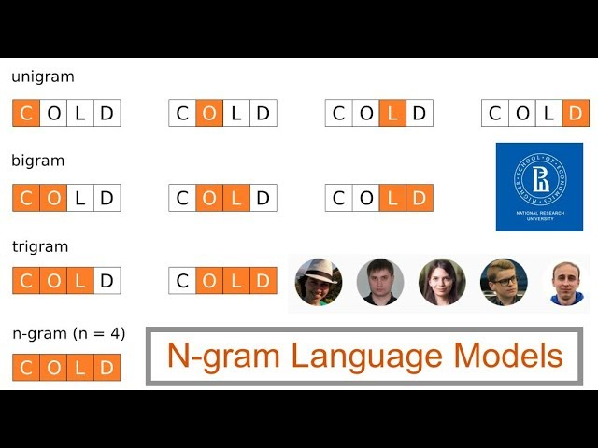
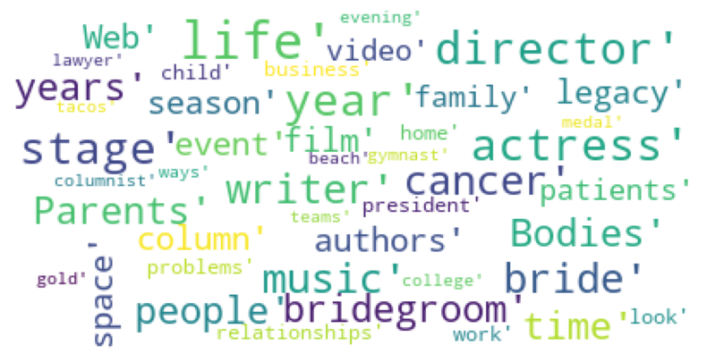
How does NLP work?
Analysis: using statistics and visualization for detecting text patterns
Word distribution & frequency, n-grams
Visualization using word clouds, histograms and heat maps
Modeling: using machine learning algorithms and other models for tasks like text classification, sentiment analysis, etc.
Notes:
Eve

Slide 47
Relevant Terms
Name entity recognition
information extraction task which groups named entities into predefined categories
Lemmatization
grouping together the inflected forms of a word into a single item
Stemming
cutting the inflected words into the root form
Part-of-speech tagging
marking part of speech based on definition and context
Parsing
Analyzing grammatical structure of text
Morphological segmentation
dividing words into morphemes to understand word structure
Word segmentation
Breaking text into words or tokens
Sentence breaking
Breaking text into sentences
Notes:
eve

Slide 48
Exploratory Data Analysis (EDA)
Working with a small subset first: one year, first 2,000 entries
Questions:
For articles mentioning a person, can we classify them as mentioning a male and female?
What is the context in which women are mentioned (wordcloud)?
Goal: Get used to Spacy, see if we can do a simple analysis.

Slide 49
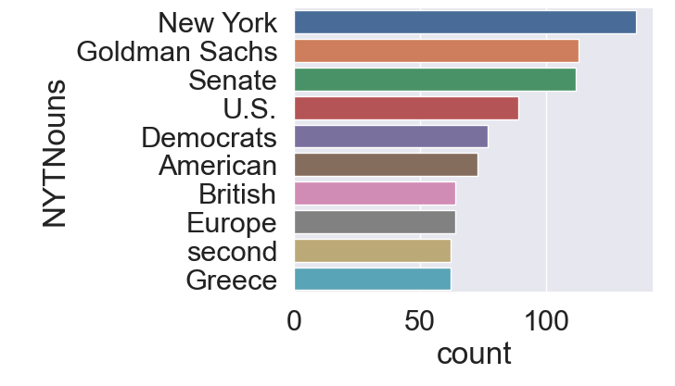
Exploratory Data Analysis (EDA)
1st step: Noun chunks
Chunking is a process of extracting phrases from unstructured text
Extracted nouns from article titles from the first 2,000 articles in 2010
Notes:
Anne

Slide 50
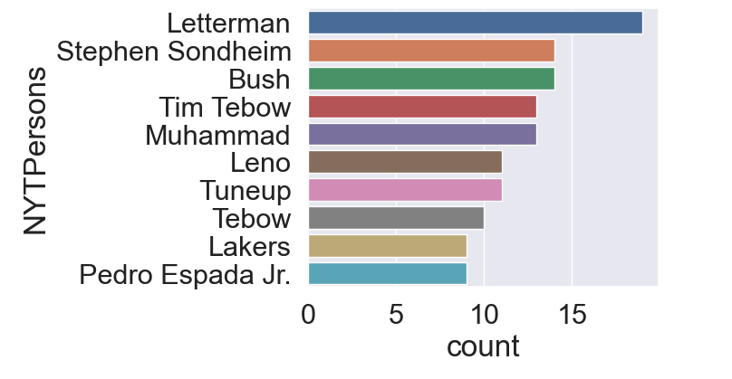
Exploratory Data Analysis (EDA)
2nd step: exploring the Person entity
Spacy can recognize names of people, including fictional
Not always accurate
Duplicates
Notes:
Anne

Slide 51

Exploratory Data Analysis (EDA)
3rd step: Using Gender Guesser library
Extracting first names
Classifying names: andy (androgynous), unknown (not in the DB), female, male, mostly_male, mostly_female
Then, isolate articles with female name
Notes:
Anne

Slide 52

Exploratory Data Analysis (EDA)
4th step: Using Word Cloud
Only ran on a very small df
Not very insightful but scalable
Goal: contextualize mentions of Female Names in a visual way
Notes:
Anne

Slide 53
Next Steps
Continued data analysis
Map how topics change over time
Visualize the frequency of women in the news over time
Google Cloud
Data too big, gotta get to the cloud
Fine tune processing for whole dataset
Model Selection & Testing
Text classification: binary classification for male vs female topics
Sentiment analysis: multi-class classification
Notes:
Eve

